Slide 1
Stride
Sprint Board
To Do
In Progress
Done
Agile Project Management System
PRESENTED BY
Mirthusha R — URK25CS6006
Lakshitha K — URK25CS6014
Department of Computer Science and Engineering
Karunya Institute of Technology and Sciences
Notes:
Hello everyone. Our project is Stride, an Agile project management system. We built it to give software teams one place to plan work, track progress, and review results during development. I am R. Mirthusha, and with me is Lakshitha K from the Computer Science and Engineering department at Karunya Institute of Technology and Sciences. In the next few minutes we will explain the problem, our solution, how it is built, and what we have tested so far.

Slide 2





Problem Statement
Tool Fragmentation
Separate tools for tasks, communication, and development.
Poor Sprint Visibility
Hard to track sprint progress and unfinished tasks.
MAIN PROBLEM
A centralized platform is needed to manage Agile project activities efficiently.
Limited Traceability
Hard to connect commits, testing, and releases.
Complex Workflows
Some tools overwhelm small teams.
Notes:
Software teams often use separate tools for tasks, chat, and code, so information ends up scattered. That makes it hard to see sprint progress, which means how much of a short development cycle is finished and what is left over. It is also hard to trace a task to its code commits, its tests, and its release. On top of that, some popular tools are too complex for small teams. So the main problem is the lack of one centralized, simple platform for managing Agile project activities.

Slide 3
Objectives
01
02
03
Develop a centralized Agile project management system.
Organize projects, backlogs, tasks, and sprints.
Track work using a Kanban board.
04
05
Improve team collaboration through discussions and retrospectives.
Support quality assurance, release management, and progress reporting.
Notes:
Our objectives follow directly from those problems. We wanted one centralized system where teams can organize projects, backlogs, tasks, and sprints. A backlog is simply the prioritized list of work that still has to be done. We also wanted a Kanban board, which shows tasks as cards moving through columns, so progress is easy to see. Finally, we aimed to support teamwork through discussions and retrospectives, along with quality assurance, release management, and progress reporting.

Slide 4






Proposed Solution
Stride — An Integrated Agile Platform
A centralized workspace for managing the software development lifecycle.
Project Management
Backlog Management
Sprint Planning
Create and organize projects.
Store and prioritize work items.
Select tasks for a specific development cycle.
Kanban Board
Collaboration
QA and Release Management
Visualize task progress.
Share discussions and review sprint outcomes.
Organize testing and release information.
Notes:
Stride is our answer: one workspace for the whole software development lifecycle. It has six core modules. Project management and backlog management store and prioritize the work. Sprint planning selects tasks for one development cycle. The Kanban board visualizes progress. Collaboration covers discussions and sprint reviews, and the QA and release module organizes testing and release information. Together, these modules connect planning, building, and delivering.

Slide 5

Novelty
QA-to-Bug Automation:
When a test case fails, Stride allows users to create a bug ticket directly from the failed test, reducing manual work and improving traceability.
Retrospective-to-Task Conversion or backlog:
Sprint retrospective action items can be converted into actual backlog tasks, helping teams turn lessons learned into improvements for the next sprint.
Automated Release Notes:
Stride automatically generates categorized Markdown release notes from completed work items, reducing manual documentation.
Key Innovation:Connecting planning, testing, team improvement, and release documentation in one integrated workflow.
Notes:
This is our technology stack. On the frontend we use React to build the interactive interface, TypeScript to catch type errors early, Vite for fast development and builds, and Tailwind CSS for styling. On the backend, Node.js runs our JavaScript server, Express.js defines the API routes and handles HTTP requests, and Zod validates incoming data against schemas. For data storage, the application currently saves its data in a local JSON file. Supabase PostgreSQL support exists in the code, but it is not connected yet.

Slide 6




Key Features
Product Backlog
Prioritized user stories, tasks, and bugs.
Quality Assurance
Test management and defect tracking.
Sprint Management
Time-boxed development cycles.
Release Management
Release information and changelogs.
Kanban Board
Tasks by To Do, In Progress, and Done.
Team Collaboration
Discussions and sprint retrospectives.
Time Tracking
Time spent on work items.
Integrations
Support for GitHub, GitLab, and CI/CD.
Notes:
Here are Stride's key features. The product backlog holds user stories, tasks, and bugs in priority order. Sprints are time-boxed cycles, and the Kanban board shows each task as To Do, In Progress, or Done. Time tracking records effort spent on work items. For quality, there is test management and defect tracking, plus release management with changelogs. Teams collaborate through discussions and retrospectives. The system also includes support for GitHub, GitLab, and CI/CD workflows, where CI/CD means automated building and delivery of code. These integrations still need to be configured and validated, which we mention in our future scope.

Slide 7


Technology Stack
FRONTEND
BACKEND
React
Builds the interactive user interface.
TypeScript
Adds static type checking to JavaScript.
Node.js Runs the backend JavaScript application.
Express.js Handles API routes and HTTP requests.
Vite
Frontend development and build tooling.
Tailwind CSS
Supports utility-based interface styling.
Zod Validates data against defined schemas.
DATA STORAGE
Local JSON Storage
Stores app data in a JSON file.
CURRENT
Supabase PostgreSQL
Cloud support exists in the codebase.
NOT CONNECTED
Notes:
This is our technology stack. On the frontend we use React to build the interactive interface, TypeScript to catch type errors early, Vite for fast development and builds, and Tailwind CSS for styling. On the backend, Node.js runs our JavaScript server, Express.js defines the API routes and handles HTTP requests, and Zod validates incoming data against schemas. For data storage, the application currently saves its data in a local JSON file. Supabase PostgreSQL support exists in the code, but it is not connected yet.

Slide 8
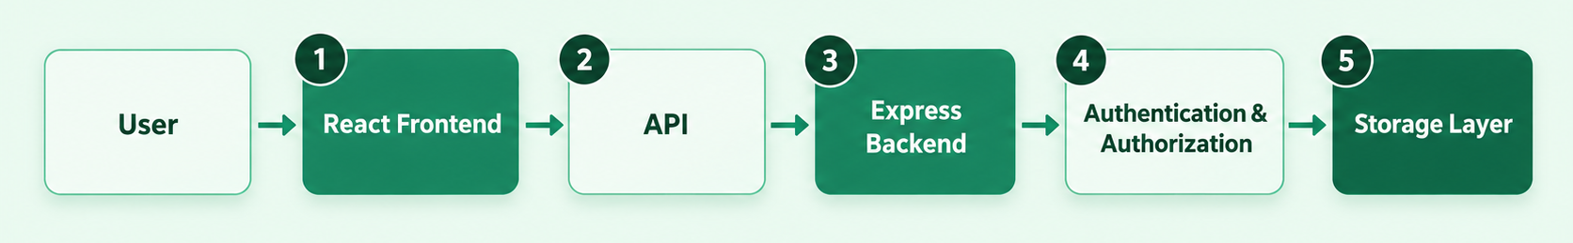
System Architecture
1
Presentation Layer
Displays the user interface and project information.
2
API Layer
Carries requests and responses between layers.
3
Application Layer
Business logic, such as creating tasks and managing sprints.
4
Authentication & Authorization
Handles user identity and access permissions.
5
Storage Layer
Saves and retrieves data using local JSON storage.
Notes:
This is how the system works. A user interacts with the React frontend. The frontend sends requests through the API, which is a REST API over HTTP, to the Express backend. The backend applies the business logic, such as creating a task or managing a sprint. It also handles authentication, which confirms who the user is, and authorization, which decides what that user is allowed to do. Finally, the storage layer saves and retrieves the data using our current local JSON storage engine.

Slide 9



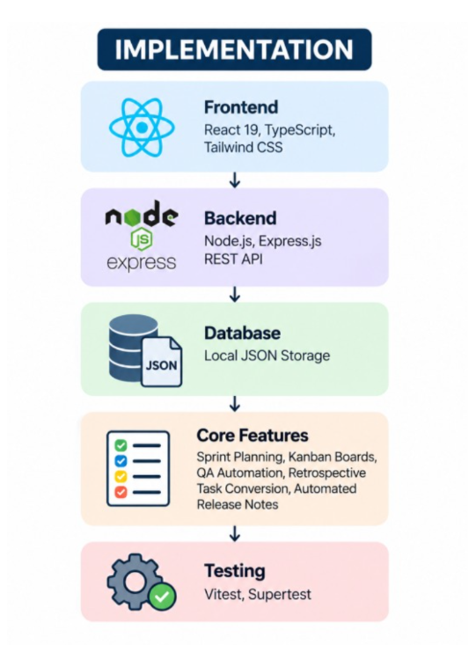
Implementation, Results & Future Scope
Implementation
Testing Results
Future Scope
Connect and verify Supabase PostgreSQL.
Complete end-to-end testing.
Configure and validate external integrations.
Improve cloud persistence, scalability, and monitoring.
86 Automated Tests Passed (checks on different system features)
18 API Checks Completed (checks of backend operations)
Build Verification (production build completed successfully)
Testing Tools: Vitest and Supertest
Notes:
To summarize: we built a full-stack web application with React and Express. It covers projects, backlog, sprints, and tasks, plus collaboration, QA, release, and reporting features. According to our project guide, 86 automated tests passed. However, browser-based Playwright testing is not complete, and production deployment and live behavior still need verification, so we are not claiming the system is production-ready. Our next steps are to connect and verify Supabase, finish end-to-end testing, validate the external integrations, and improve cloud persistence, scalability, and monitoring.

Slide 10
CONCLUSION
Stride integrates Agile project management into one platform.
Automates QA-to-bug conversion and retrospective task creation.
Generates release notes from completed work items.
Reduces manual effort and improves workflow traceability.
Supports efficient team collaboration and software delivery.
REFERENCE
1. Lehtinen, T. O. A., et al. (2017). Recurring Opinions or Productive Improvements in Agile Retrospectives. Read paper
2. Ruiz, M., et al. (2023). Why Don’t We Trace? A Study on the Barriers to Software Traceability in Practice. Read paper
3. Koboyatshwene, T., & Ayalew, Y. (2025). Requirements Traceability: A Systematic Literature Review. Read paper
Notes:
This is our technology stack. On the frontend we use React to build the interactive interface, TypeScript to catch type errors early, Vite for fast development and builds, and Tailwind CSS for styling. On the backend, Node.js runs our JavaScript server, Express.js defines the API routes and handles HTTP requests, and Zod validates incoming data against schemas. For data storage, the application currently saves its data in a local JSON file. Supabase PostgreSQL support exists in the code, but it is not connected yet.

Slide 11
Thank You
Stride — Agile Project Management System
Notes:
Thank you for listening. Stride shows how one integrated platform can bring Agile planning, tracking, quality assurance, and release management together. We are happy to answer your questions.

